Slide 1

HOSTING IN NEW YORK WITH AIRBNB
PART-II
GROUP-9

Slide 2
About the data set…
16 variables
48895 observations
id | Room_type
name | price
host_name | minimum_nights
host_id | number_of_reviews
neighbourhood_group | last_review
neighbourhood | reviews_per_month
latitude | calculated_host_listings_count
longitude | availability_365
Year_cat
No reviews
Last 6 months
1 year back
2 years back
3 years back
4 years back
5 years back
6 years back
7 years back
8 years back

Slide 3

OBJECTIVE
“Providing the hosts with an estimate on the amount they could earn per night from their listing”

Slide 4

Recap from the descriptive analysis…

Slide 5
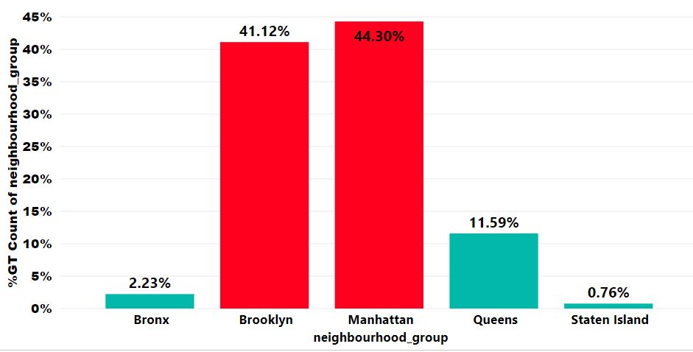
No missing value imputations
Manhattan and Brooklyn has the most number of listings

Slide 6
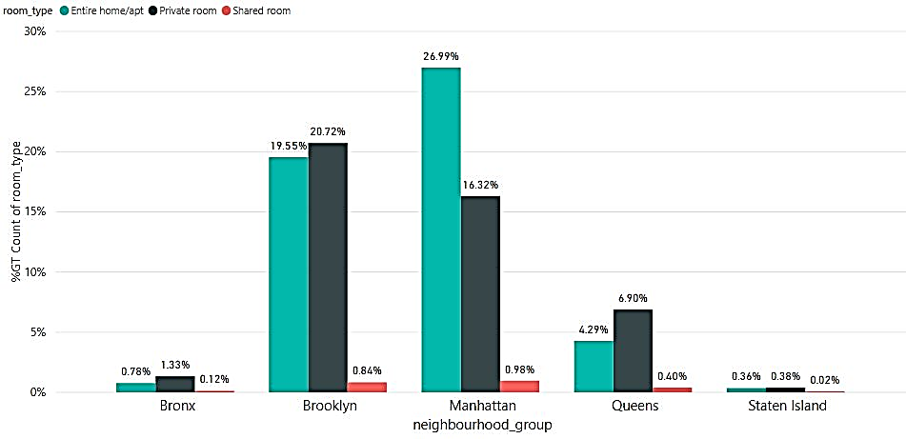
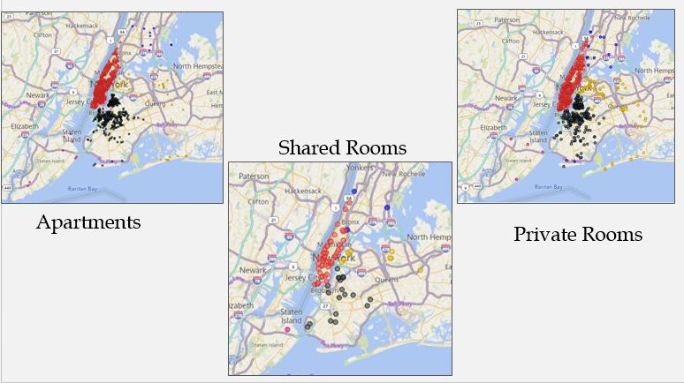
Shared rooms are less popular in all boroughs
Outliers in price cannot be discarded

Slide 7

There were significant associations among categorical predictor variables
 | Borough | Year of last review | Host group | Room type
Borough | - | 0.0606 | 0.1368 | 0.1263
Year of last review |  |  | 0.1711 | 0.0316
Host group |  |  |  | 0.1943
Room

Slide 8
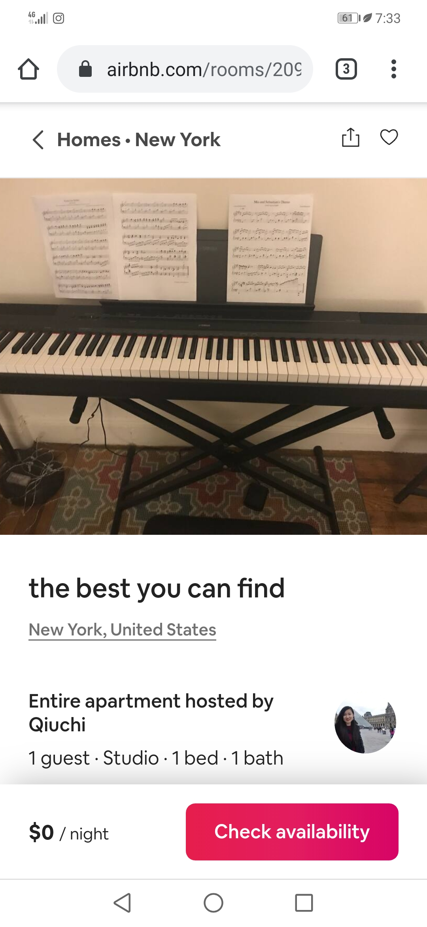
Data Cleaning …
There were 11 listings with price = $0
Tracked the listings using listing id
10 out of 11 had their price in the website
Discarded the remaining listing with price = 0

Slide 9

Suggested Advanced Analysis Techniques…
Ridge Regression
Lasso Regression
Elastic net Regression
Support Vector Regression

Slide 10
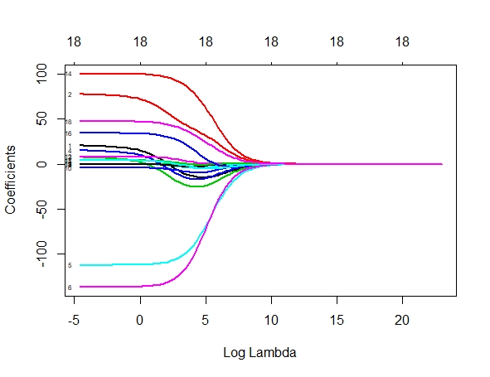
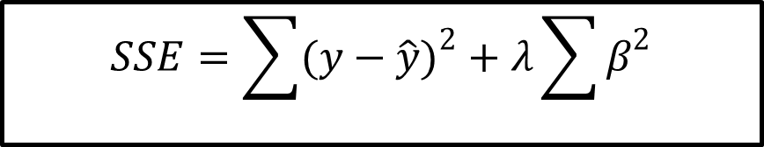
Results from Ridge Regression…
$$SSE=\sum{{(y−\hat{y})}^{2}}+λ\sum{β^{2}}$$

Slide 11
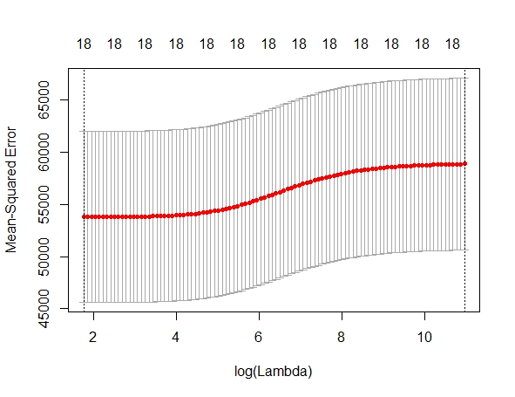
Results from Ridge Regression…
Best Lambda : 5.785993
Test MSE : 47867.57
Test MSE for 1sd Lambda :52634.26

Slide 12
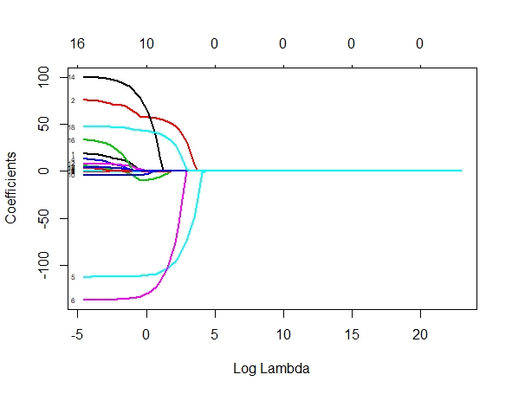
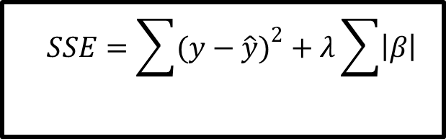
Results from Lasso Regression…
$$SSE=\sum{{(y−\hat{y})}^{2}}+λ\sum{\left|β\right|}$$

Slide 13
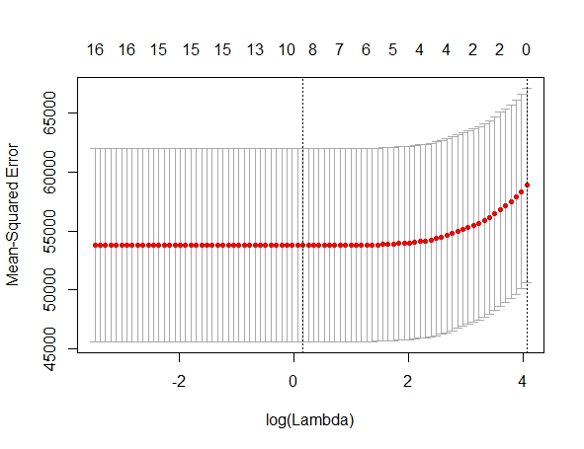
Results from Lasso Regression…
Best Lambda : 1.162541
Test MSE : 47877.37
Test MSE for 1sd Lambda : 52621.78

Slide 14
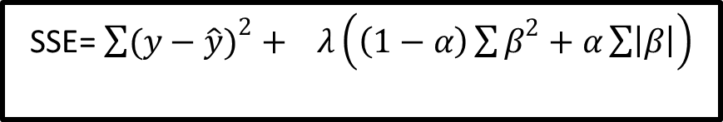
Results from Elastic Net Regression
SSE= $\sum{{(y−\hat{y})}^{2}}+ λ\left(\left(1−α\right)\sum{β^{2}}+α\sum{\left|β\right|}\right)$
Alpha | MSE | Best Lambda
0.50 | 47876.36 | 2.118528
0.55 | 47876.32 | 1.925934
0.60 | 47876.22 | 1.765440
0.65 | 47876.36 | 1.629637
0.70 | 47877.31 | 1.660773
0.75 | 47877.34 | 1.550055
0.80 | 47877.21 | 1.453176
0.85 | 47877.23 | 1.367695
0.90 | 47877.35 | 1.291712
Alpha | MSE | Best Lambda
0.10 | 47862.24 | 1.246554
0.15 | 47874.09 | 5.341962
0.20 | 47873.86 | 4.006472
0.25 | 47873.85 | 3.205177
0.30 | 47874.55 | 2.931398
0.35 | 47874.63 | 2.512627
0.40 | 47875.41 | 2.412905
0.45 | 47875.38 | 2.144804

Slide 15
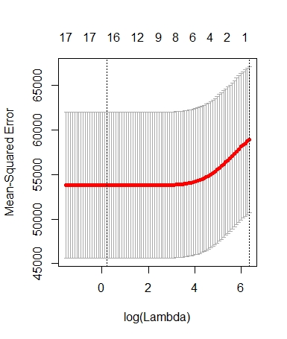
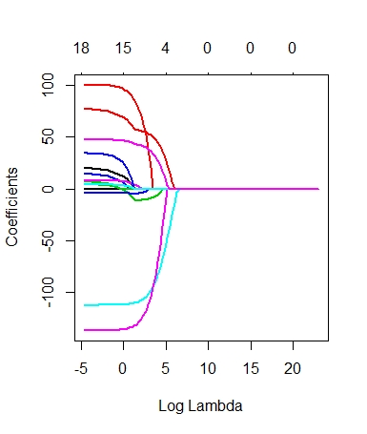
Results from Elastic Net Regression

Slide 16
Best Model…
Ridge Regression | Lasso Regression | Elastic Net Regression
47867.57 | 47877.37 | 47862.24
Price = 161.80702 + 66.93858*Manhattan + 12.21414*Brooklyn - 0.3644533*Queens + 3.017818*Staten_Island – 0.01110575*private_room – 136.0788*Shared_room + 0.07742775*minimum_nights – 0.1146004*number_of_reviews + 0.009809262*host_listings_count -4.966521*two_years_back + 9.918175*four_years_back + 81.74598*six_yrs_back + 0.7322615*seven_years_back + 58.34354*eight_years_back +4.755247*last_six_months

Slide 17
Results from Support Vector Regression
Considering the total dataset
Kernel function | Radial | Polynomial | Linear | Sigmoid
Test MSE | 35200 | 35564.7 | 35753.46 | 894475519

Slide 18
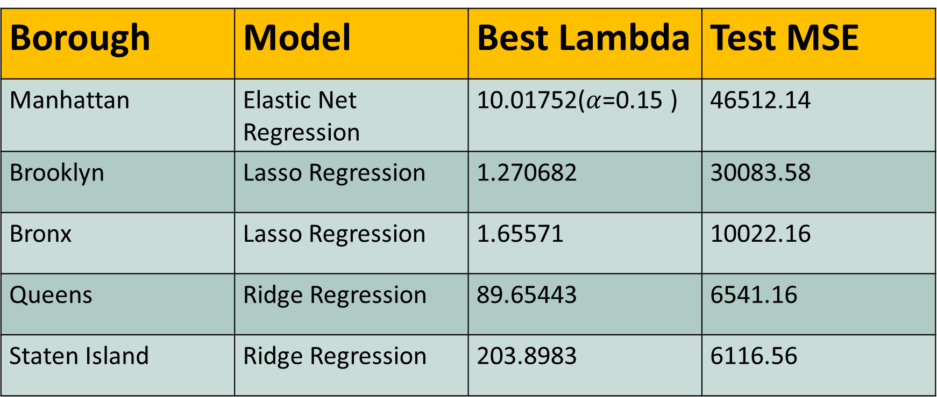
From the separate data sets…
Borough | Model | Best Lambda | Test MSE
Manhattan | Elastic Net Regression | 10.01752($α$=0.15 ) | 46512.14
Brooklyn | Lasso Regression | 1.270682 | 30083.58
Bronx | Lasso Regression | 1.65571 | 10022.16
Queens | Ridge Regression | 89.65443 | 6541.16
Staten Island | Ridge Regression | 203.8983 | 6116.56

Slide 19
Results from Support Vector Regression
Considering the separate datasets(Test MSE values)
 | Radial | Polynomial | Linear | Sigmoid
Manhattan | 46942.71 | 47954.92 | 47698.4 | 2670744206
Brooklyn | 30661.89 | 30986.22 | 30918.63 | 84999742
Bronx | 10497.71 | 10929.08 | 10658.7 | 36003.98
Queens | 6465.905 | 26982.99 | 7699.397 | 13524962
Staten Island | 2361.865 | 3169.462 | 1962.114 | 14500.75

Slide 20
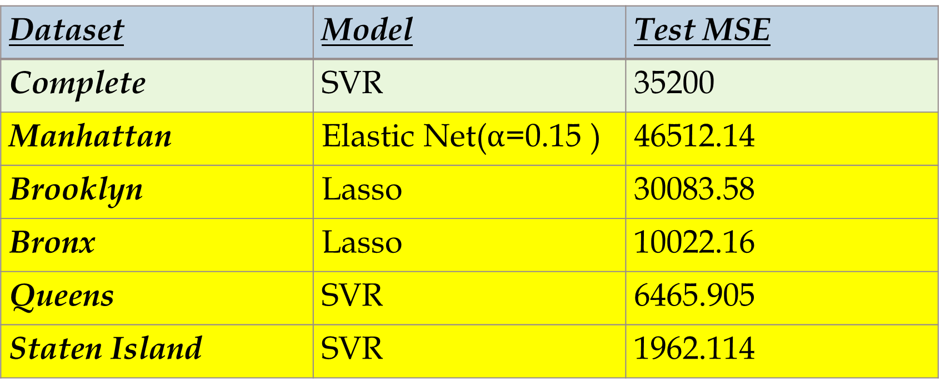
Final Model
Dataset | Model | Test MSE
Complete | SVR | 35200
Manhattan | Elastic Net($α$=0.15 ) | 46512.14
Brooklyn | Lasso | 30083.58
Bronx | Lasso | 10022.16
Queens | SVR | 6465.905
Staten Island | SVR | 1962.114

Slide 21
Price = 232.6216861 – 22.1127525*private_room – 143.9328269*Shared_room – 0.1098396*number_of_reviews -11.9854636*two_yrs_back -6.2541064*three_yrs_back+ 5.7990967*four_years_back + 128.7231864*six_yrs_back +3.5897896*last_six_months
Manhattan
Price = 174.79101095 – 100.70669167*private_room – 121.42688028*Shared_room – 0.05505553*number_of_reviews + 14.77842724*last_six_months
Brooklyn
Price = 124.84156808 – 58.15772915*private_room – 65.19817697*Shared_room – 0.33873675*minimum_nights-0.06397561*number_of_reviews +0.89795745*host_listings_count -6.26998550*last_six_months
Bronx

Slide 22
Problems faced…
Problem
Including the variables neighbourhood_group and neighbourhood in the model.
There were many levels for the variable neighbourhood.
Though we separated the dataset according to the boroughs, the No. of listings for some categories in the variable wasn’t sufficient
Solution
Remove the variable neighbourhood and fit the models.

Slide 23
Problems faced…
Problem
Very high Test MSE values
Couldn’t achieve much reduction in Test MSE after separating the data
Solution
Fit the data after separating the dataset into 5 according to the neighbourhood_group
Go for an advanced approach such as deep learning

Slide 24
Problems faced…
Problem
Including support vector regression in the data product
Solution
Used the best model among the other models for the data product
Hope to improve the data product after a thorough study on SVR.

Slide 25

Reasons for unsatisfactory results…
Source : http://insideairbnb.com/get-the-data.html
The dataset isn’t related to the price which a customer actually pays – business dataset

Slide 26

Data Product

Slide 27
References
Gareth James ,Daniela Witten ,Trevor Hastie,Robert Tibshirani-An Introduction to Statistical Learning with Applications in R
https://www.r-bloggers.com/variable-selection-with-elastic-net/
http://wavedatalab.github.io/machinelearningwithr/post4.html
https://Dataquest.io/blog/machine-learning-tutorial/
https://www.datacamp.com/community/tutorials/tutorial-ridge-lasso-elastic- net
Gareth James ,Daniela Witten ,Trevor Hastie,Robert Tibshirani-An Introduction to Statistical Learning with Applications in R
Spring 5-31-2017,Housing Price prediction Using Support Vector Regression, Jiao Yang Wu,San Jose State University
https://towardsdatascience.com/walking-through-support-vector-regression-and-lstms-with-stock-price-prediction-45e11b620650
https://medium.com/coinmonks/support-vector-regression-or-svr-8eb3acf6d0ff
Automate the boring stuff with python by Al Swegart
http://blog.cambridgespark.com
https://shiny.rstudio.com/tutorial
https://www.listendata.com/2018/02/shiny-tutorial-r.html?m=1

Slide 28

THANK
YOU…
Group - 9
Chamodi Perera S13566
Migara Devinda S13370
Sathsara Rasantha S13630

